Slide 1
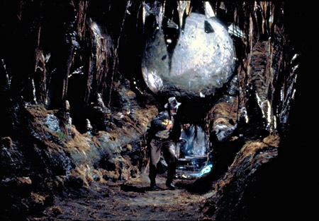
Standards for
Post-Quantum Cryptography
Yi-Kai Liu / NIST PQC team
http://indianajones.wikia.com/wiki/Raiders_of_the_Lost_Ark

Slide 2
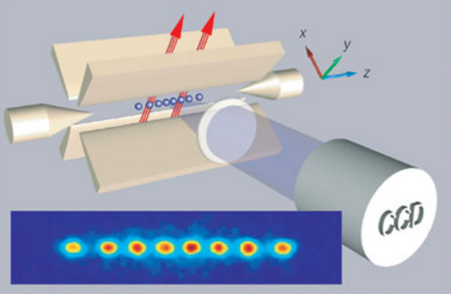
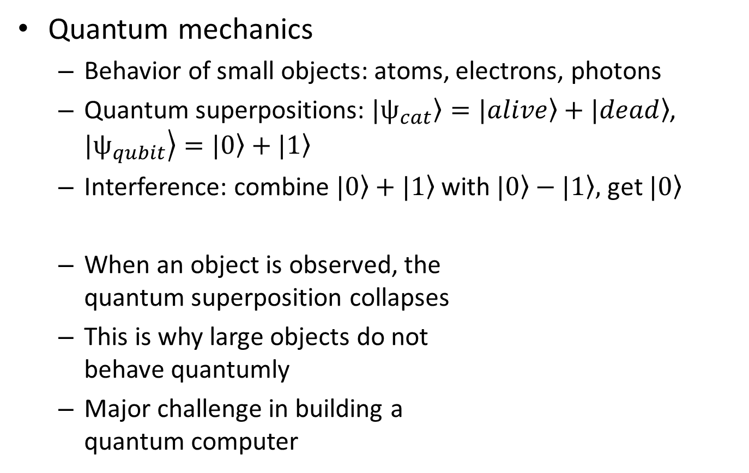
Quantum Computers
Quantum mechanics
  Behavior of small objects: atoms, electrons, photons
  Quantum superpositions: $|\left.ψ_{cat}\right\rangle =|\left.alive\right\rangle +|\left.dead\right\rangle$, $|\left.ψ_{qubit}\right\rangle =|\left.0\right\rangle +|\left.1\right\rangle$
  Interference: combine $|\left.0\right\rangle +|\left.1\right\rangle$ with $|\left.0\right\rangle −|\left.1\right\rangle ,$ get $|\left.0\right\rangle$
  When an object is observed, the
  quantum superposition collapses
  This is why large objects do not
  behave quantumly
  Major challenge in building a
  quantum computer
R.Blatt & D. Wineland, Nature 453,
1008-1015 (19 June 2008)

Slide 3
Quantum Computers
Potentially much more powerful than classical computers
  Conjecture: A classical computer needs exponential time to simulate a quantum computer (in the general case)
Exponential speedups for some interesting problems
  Simulating the dynamics of molecules, superconductors, photosynthesis…?
  Factoring large integers (Shor’s algorithm)
  Discrete logarithms in any abelian group (Shor’s algorithm)
And some polynomial speedups
  Unstructured search (Grover’s alg.), collision finding

Slide 4
Who Cares?
Quantum computers would break most of our public-key crypto
  RSA, Diffie-Hellman key exchange, elliptic curve crypto
  TLS, digital certificates, IPSec
Symmetric crypto would be affected, but not broken
  “Keep using AES, but double the key length”
  (Actually, it’s more complicated than that)

Slide 5
Who Cares?
Fortunately, large quantum computers don’t exist yet
  Small ones do exist, but can they scale up?
  Michele Mosca (http://eprint.iacr.org/2015/1075):
  “1/2 chance of breaking RSA-2048 by 2031”
Unfortunately, 2031 is not that far away
  How long does today’s data need to remain secure?
  5-10 years?
  How long does it take to deploy new crypto software?
  5-10 years?

Slide 6
Post-Quantum Cryptography
Cryptosystems | Hard problem | Trapdoor
Lattice-based | Finding short vectors in a high-dimensional lattice | Nice basis for the lattice (short, almost-orthogonal vectors)
Code-based | Decoding a random binary linear code | Linear trans-formations that reveal structure of the code
Multivariate | Solving a random system of multivariate quadratic equations over a finite field | Linear trans-formations that reveal structure of the equations

Slide 7
Post-Quantum Cryptography
Hash-based signatures
  Simple: uses only a hash function, doesn’t need a trapdoor
  Caveat: signing algorithm has to update an internal data structure every time it signs a message
Isogenies of supersingular elliptic curves
  Useful for key exchange?
Quantum key distribution
  Information-theoretic security
  Requires optical fiber, distance limited to ~200 km

Slide 8

Post-Quantum Cryptography
How do we know a cryptosystem is secure?
  Cryptanalysis: what are the best known attacks?
  Security proofs: based on some hardness assumption?
How well do these cryptosystems work in practice?
  Size of keys, time needed for each operation
  Ease of implementation, how to set the parameters
  Does it fit nicely with TLS, other higher-level protocols?
  Vulnerabilities to side channel attacks?
There’s a conference about this:

Slide 9
Lattice-Based Cryptography

Slide 10
Lattice-Based Encryption Schemes
NTRUEncrypt
  Developed circa 1996 by Hofstein, Pipher and Silverman, commercially available
Regev’s encryption scheme
  Based on LWE problem (“learning with errors”) (2005)
    Solving a noisy system of linear equations modulo p
  Theoretical security guarantees
    Solving average-case instances of LWE is at least as hard as solving worst-case instances of SIVP (“lattice short independent vectors problem”)
  When instantiated with ideal lattices, this looks sort of like NTRUEncrypt
    Ideal lattice: an ideal in a ring, for example, Z[X] / (X^{n}+1)
    This gives smaller key sizes, without compromising security?

Slide 11
LWE Problem (“learning with errors”)
Secret s in (Z_{q})^{n}
  q = poly(n)
Given samples (a,b) in (Z_{q})^{n} x Z_{q}
  a is uniformly random
  b = a^{T}s + e, where e is Gaussian distributed, w/ std dev q/poly(n)
Can we determine s?
  “Decoding a random linear code over Z_{q}”
Claim: samples (a,b) look pseudorandom!

Slide 12
Regev’s Encryption Scheme
Private key: s in (Z_{q})^{n}
Public key: LWE samples (a_{i}, b_{i}) in (Z_{q})^{n} x Z_{q} (for i = 1,…,m)
  Where we let m ~ n log n
  Recall b_{i} = a_{i}^{T}s + e_{i}
Encryption: Given a single bit x in {0,1}
  Choose a random subset S of {1,…,m}
  Output a = Σ_{i in S} a_{i} and b = (0.5)(q-1)x + Σ_{i in S} b_{i}
Decryption: Given (a,b)
  Compute b – a^{T}s = (0.5)(q-1)x + Σ_{i in S} e_{i}
  Round this to either 0 or (0.5)(q-1), mod q
  Output either x = 0 or x = 1, accordingly

Slide 13
Lattice-Based Signatures
“Hash-then-sign” approach (GGH ’97)
Lattice L
Public key: A “hard” basis B
Private key: A “good” basis T (the “trapdoor”)
Signing: Given message m,
  Hash it to a point x in R^{n}
  Find the lattice vector v in L that lies closest to x
  Output (x,v)
Verification: Given (m,x,v),
  Check that m hashes to x, v is in L, and v is close to x

Slide 14
Lattice-Based Signatures
NTRUSign
  Developed circa 2003
  Broken by Nguyen and Regev in 2006 (“learning a parallelipiped”) – each signature leaks some information about the secret key
  Patched by adding “perturbations” to the signatures
GPV signatures
  Uses “Gaussian sampling” (Gentry, Peikert, Vaikuntanathan, 2007)
    Provably secure variant of NTRUSign, but less efficient
    Based on SIS problem (“small integer solutions”) –
    random subset sum with vectors modulo p
    Has worst-case to average-case reduction from lattice problems

Slide 15
Lattice-Based Signatures
Signatures using Fiat-Shamir heuristic
  More efficient than GPV approach
  Provably secure based on hardness of SIS problem,
  in random oracle model
  Lyubashevsky (2011), and several follow-on works…

Slide 16
Cryptanalysis
Lattice basis reduction (in polynomial time)
  Try to find a basis consisting of short, nearly-orthogonal vectors
  LLL algorithm: finds a 2^{O(n)}-approximation to the shortest vector in the lattice
  Block-KZ reduction, follow-on work by Schnorr, Nguyen…
Sieving, enumeration (in exponential time)
  Find the shortest vector in the lattice
  Extreme pruning (Gama, Nguyen, Regev, 2010)
Algorithms for LWE and SIS problems
  List merging (Lyubashevsky, 2004)
  Linearization (Arora, Ge, 2011)

Slide 17
Quantum Cryptanalysis?
Quantum algorithms for problems in number fields
  Unit group, class group, principal ideal problem
  Running time is polynomial in the degree
  (Eisentrager, Hallgren, Kitaev, Song, 2014; Biasse, Song, 2016)
Quantum attack on the Soliloquy cryptosystem
  (Campbell, Groves, Shepherd, 2014)
    Commentary: http://web.eecs.umich.edu/~cpeikert/soliloquy.html
Quantum speed-ups of classical lattice algorithms
  (Laarhoven, Mosca, van de Pol, 2013)

Slide 18
Issues and Open Questions
Are ideal lattices just as hard as general lattices?
  Clearly there is some additional structure there…
  In the security proofs, we assume these problems are hard
How hard are the LWE and SIS problems, for the parameters we use in practice?
  Parameters are chosen based on experimental cryptanalysis
  Worst-case to average-case reduction doesn’t say anything meaningful in this regime
How to implement Gaussian samplers?
  Need good entropy, how to test this, what about discretization errors, need constant-time implementations to resist side-channel attacks…

